Slide 1
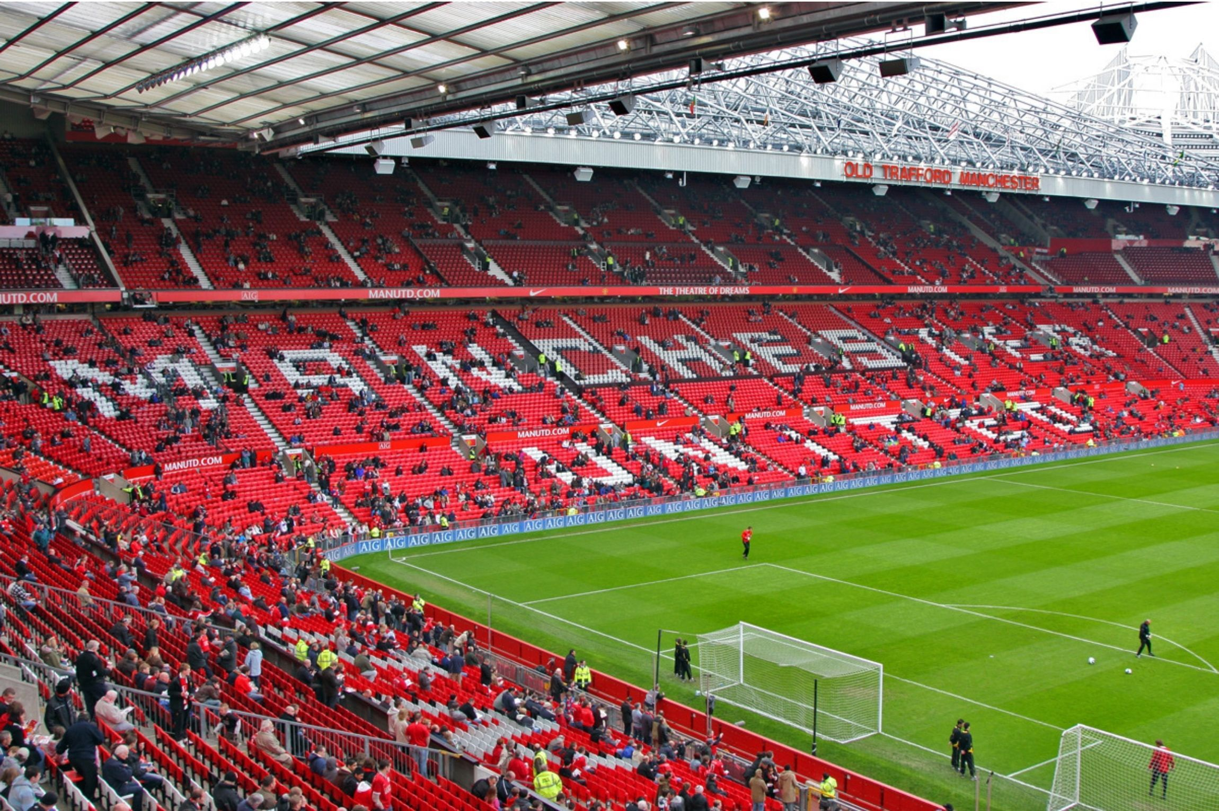
Sport Travel Guider
By Dan, Gan & Matt

Slide 2


Slide 3
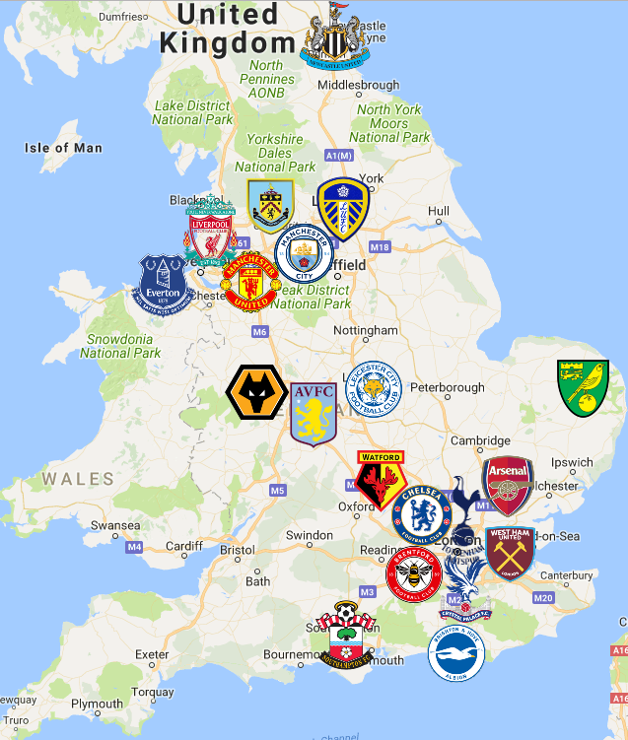

Slide 4



Tech Used

Slide 5
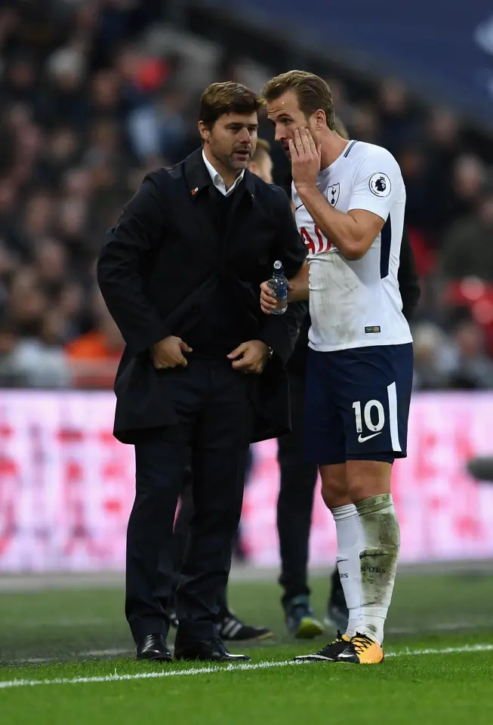
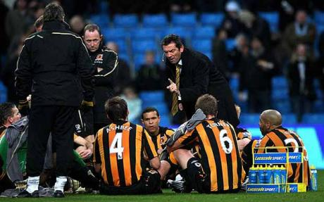
Brainstorming & Breakdown of roles

Slide 6
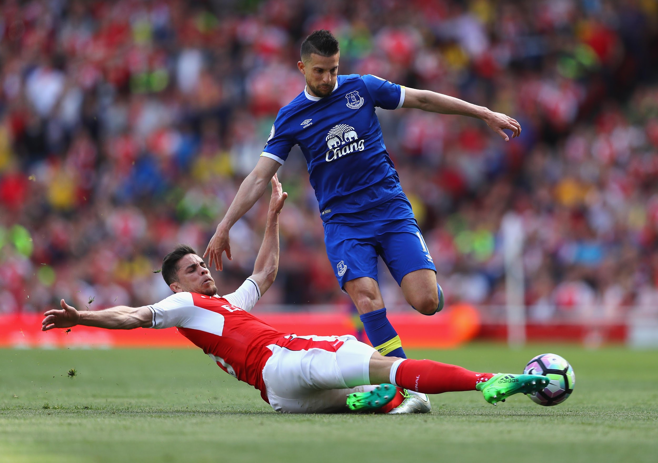
Challenges

Slide 7

Successes!!

Slide 8
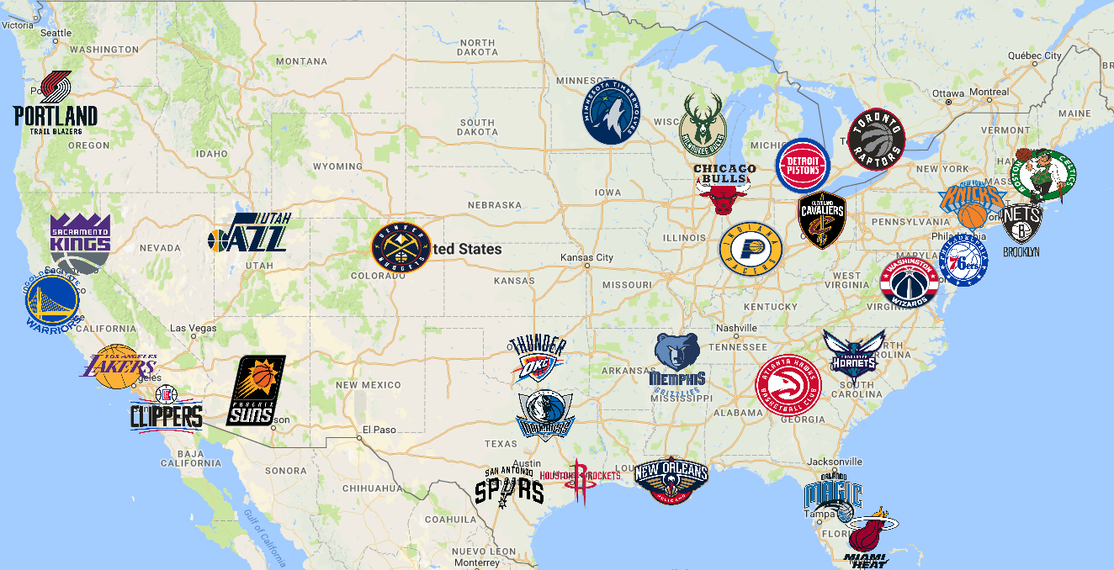
Directions for Future Development

Slide 9
Links
https://github.com/DanLawrence91/team-project
https://protected-retreat-83410.herokuapp.com

